Slide 1
Quantitative trait locus mapping in multiparent crosses
Daniel Gatti, Ph.D
June 13, 2019

Slide 2

Outline
Laboratory mice
Quantitative Trait Locus (QTL) mapping in two parent crosses
QTL mapping in eight parent crosses
Genotyping
Mapping
QTL mapping example
Chemotherapy Toxicity
<number>

Slide 3
Outline
Laboratory mice
QTL mapping in two parent crosses
QTL mapping in eight parent crosses
Genotyping
Mapping
Diversity Outbred QTL mapping example
Chemotherapy Toxicity
<number>

Slide 4
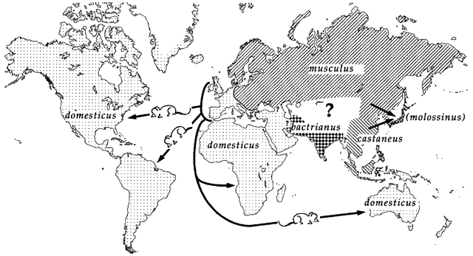
Laboratory mice descend from several parts of the world
Silver, Bonhomme

Slide 5
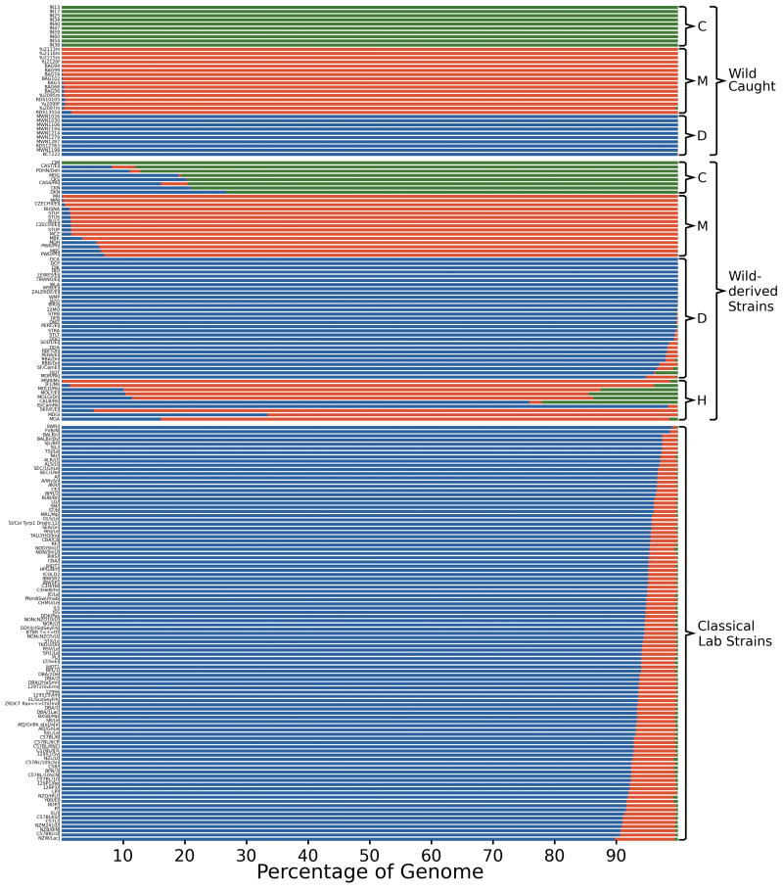
Classical inbred strains have limited genetic diversity
M.m. domesticus
M.m. musculus
Wild Caught Mice
M.m. castaneus
Wild Derived Inbred Strains
Classical Inbred Lab Strains
Yang et.at., Nat. Gen. 2011

Slide 6
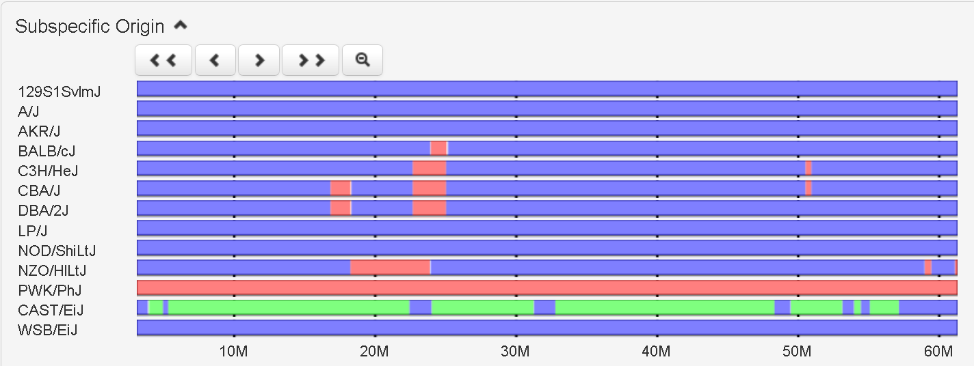
Mouse Phylogeny Viewer shows you genetic diversity between mouse strains
http://msub.csbio.unc.edu/
Chr 19
M.m. domesticus
M.m. musculus
M.m. castaneus
Jeremy R. Wang, Fernando Pardo-Manuel de Villena, & Leonard McMillan. Comparative analysis and visualization of multiple collinear genomes. BMC Bioinformatics, 2012.
Notes:
If you want to make a cross from two strains are genetically diverse on Chr 19 at 20 Mb, which two would you select?
<number>

Slide 7
Laboratory mice are usually Inbred
Brother/sister mating for more than 20 generations.
Breed until mice are homozygous at most loci.
All members of an inbred strain have identical genetic composition.
Fixes phenotypes in each strain for further study.
The Jackson Laboratory has hundreds of inbred strains. http://jaxmice.jax.org/
Many have been phenotyped: http://phenome.jax.org
<number>

Slide 8
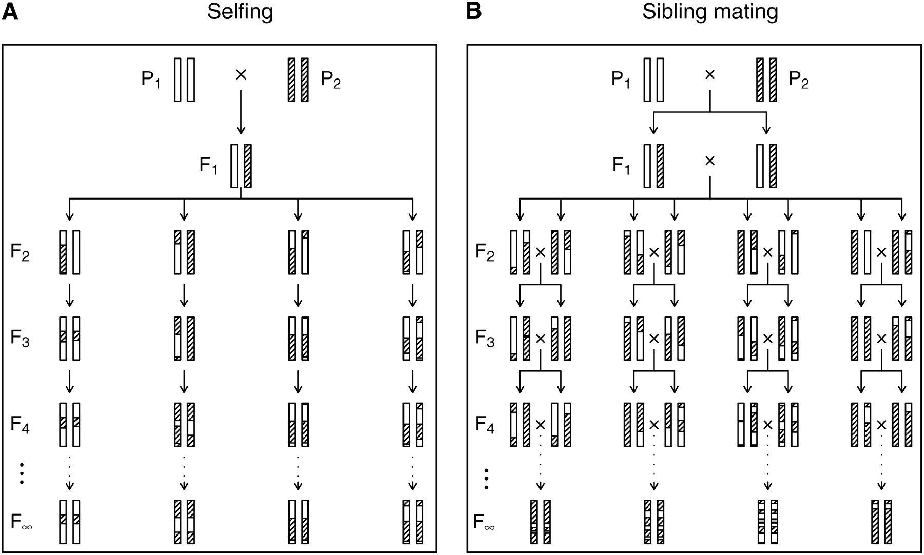
The production of recombinant inbred lines by selfing (A) and by sibling mating (B).
Karl W. Broman Genetics 2005;169:1133-1146
<number>

Slide 9
Quantitative Trait Locus (QTL) Mapping
QTL mapping is a method for finding genes related to a trait of interest (i.e. cholesterol).
Control environment & vary genetics.
Panel of genetically diverse mice with different cholesterol levels. (n = 200 to 300+)
Use correlation between genotypes and phenotypes of mice to find genes.

Slide 10
Single Nucleotide Polymorphisms (SNPs) act as markers along the genome
SNPs are single nucleotides in DNA that have different alleles in different mouse strains.
SNPs are used to distinguish segments of DNA.
C57BL/6J
DBA/2J
CTACTGACGACTCAGTGTACGATCGACT
CTACTGACGACGCAGTGTACGATCGACT
SNP

Slide 11
A
B
Inbred Founder Strains
X
F1 Generation
X
F2
Notes:
Which mitochondrial chromosome will the F2s have?
Which Y chromosome will the male F2s have?
<number>

Slide 12
A
B
Inbred Founder Strains
X
F1 Generation
X
SNP 1
SNP 2
F2
SNP 3
SNP 1 | AA | BB | AB | AB | BB | AA | BB | AA
SNP 2 | AB | AB | AB | AB | BB | AA | AB | AB
SNP 3 | BB | AA | AB | AB | BB | BB | AA | AB
Notes:
<number>

Slide 13
Haplotype Reconstruction is performed using a Hidden Markov Model (HMM)
Markers along chromosome
SNP1 | SNP2 | SNP3 | SNP4 | SNP5 | SNP6 | SNP7 | SNP8 | SNP9 | SNP10 | SNP11 | SNP12 | SNP13
A | A | T | G | C | C | T | G | A | G | G | C | A
C | G | G | A | T | T | A | A | G | T | T | G | C
A | A | T | G | T | T | A | A | G | T | G | C | A
A | A | G | A | T | T | T | G | A | G | G | C | A
C57BL/6J
DBA/2J
BxD F2 #1
BxD F2 #2

Slide 14
Cholesterol
Variation
Mouse

Slide 15
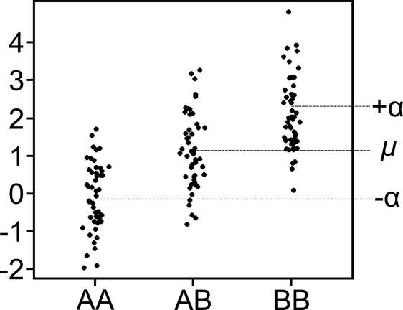
Quantitative Trait Locus (QTL) Mapping
Phenotype mean
Genotype of animal i at marker m
Allele effect of marker m
Phenotype of animal i at marker m
$y_{im}=μ+g_{im}α_{m}+ε_{im}$
Residual error for animal i

Slide 16
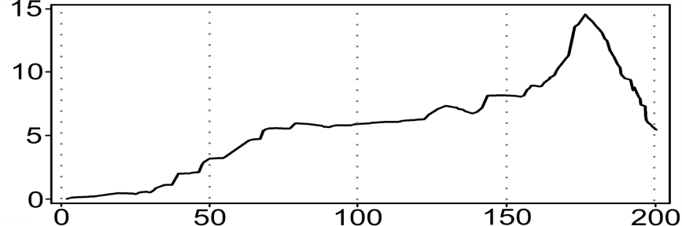
Cholesterol
AA
AB
BB
AA
AB
BB
AA
AB
BB
LOD
Chr 1 (Mb)

Slide 17
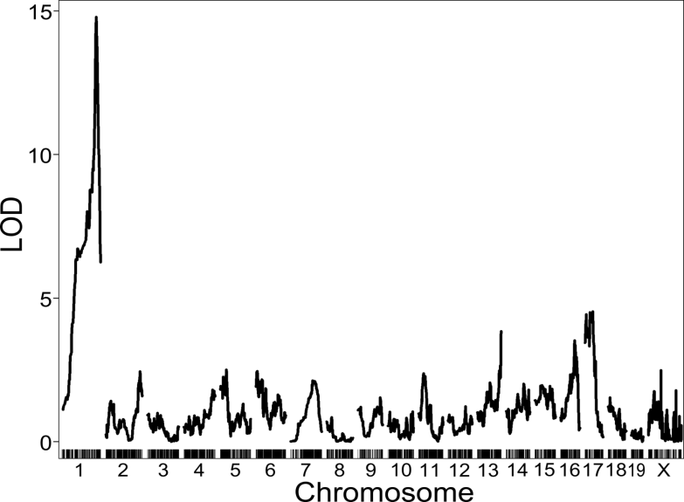
Genome Scan for Cholesterol

Slide 18
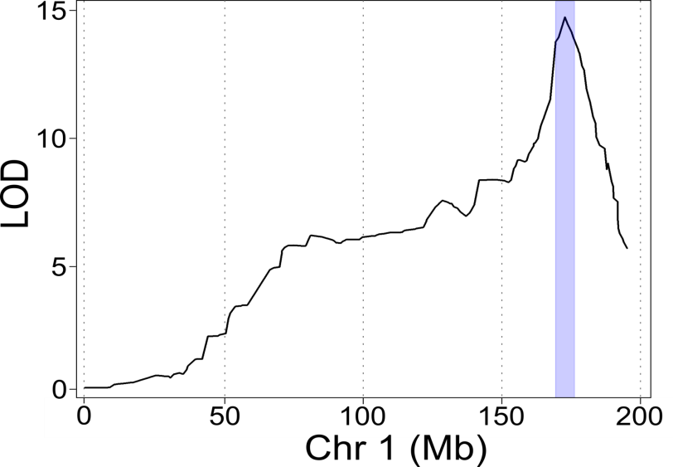
Support Interval around QTL Peak
171 – 178 Mb

Slide 19
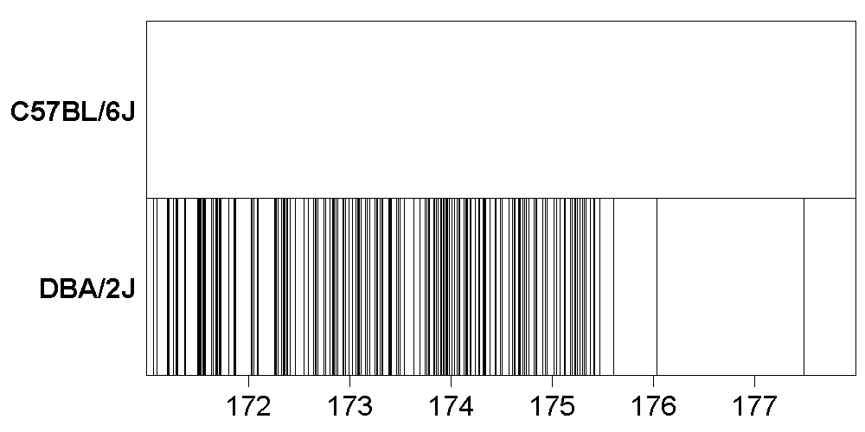
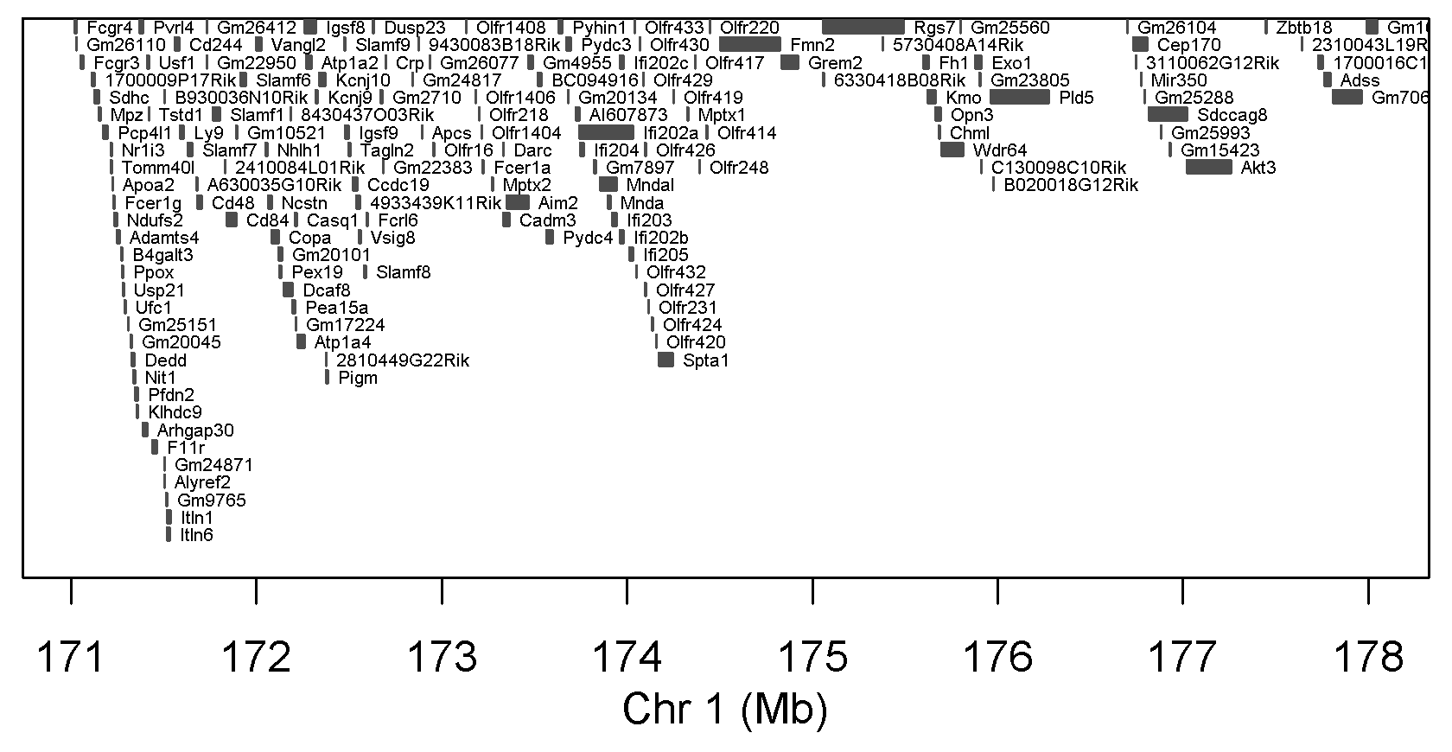
A
B
44,315
SNPs
153 Genes

Slide 20
Pros and Cons of F2 population
Pro | Con
Easy to create | Low genetic diversity (only 2 parental strains) masks much of the genome
High statistical power | Wide confidence intervals with many genes
High minor allele frequency (50%)
<number>

Slide 21
Outline
Laboratory mice
QTL mapping in two parent crosses
QTL mapping in multi-parent crosses
Genotyping
Mapping
Diversity Outbred QTL mapping example
Chemotherapy Toxicity
<number>

Slide 22
Much of the human genome can be mapped onto the mouse genome
Ali et al., BMC Bioinf., 2013
<number>

Slide 23
What if we could engineer a SNP in every gene?
Ali et al., BMC Bioinf., 2013
<number>

Slide 24
Reviews on QTL Mapping
Dissecting quantitative traits in mice.
Annu Rev Genomics Hum Genet. 2013;14:421-39
Mott R, Flint J.
http://www.ncbi.nlm.nih.gov/pubmed/23834320
Genome-wide association studies in mice.
Nat Rev Genet. 2012 Nov;13(11):807-17.
Flint J, Eskin E.
http://www.ncbi.nlm.nih.gov/pubmed/23044826
Fine-mapping QTLs in advanced intercross lines and other outbred populations.
Mamm Genome. 2014 Aug;25(7-8):271-92
Gonzales NM, Palmer AA.
http://www.ncbi.nlm.nih.gov/pubmed/24906874
<number>

Slide 25
Multi-parent Advanced Generation Intercrosses (MAGIC)
Increase genetic diversity.
Use two distantly related founder strains.
Use more than two founder strains.
Increase the number of recombinations (and hence, mapping resolution).
Cross lines for more generations.

Slide 26
Organisms with MAGIC lines
Arabadopsis: http://journals.plos.org/plosgenetics/article?id=10.1371/journal.pgen.1000551
Wheat: http://www.g3journal.org/content/4/9/1603.full
Maize: http://www.genetics.org/content/198/4/1717.full
Fruit Fly: http://wfitch.bio.uci.edu/~dspr/
Rat: http://www.nature.com/ng/journal/v45/n7/full/ng.2644.html
Mouse: http://csbio.unc.edu/CCstatus/index.py
http://mus.well.ox.ac.uk/CC/
http://do.jax.org
Others….

Slide 27
Founder Strains: Color/Letter Codes
Millions of SNPs
4.2
0
4.4
4.3
4.5
17.7
17.2
6.0
A/J
C57BL/6J
129S1/SvImJ
NOD/ShiLtJ
NZO/HlLtJ
CAST/EiJ
PWK/PhJ
WSB/EiJ
A
B
C
D
E
F
G
H
Classical Inbred
Wild Derived Inbred
Keane, TM, Nature, 2011
Notes:
<number>

Slide 28
Founder Strains
All eight founders have been fully sequenced.
SNPs, short indels and larger structural variants are known.
Unlike human association mapping, we have the causal variants for many phenotypes.
Notes:
<number>

Slide 29
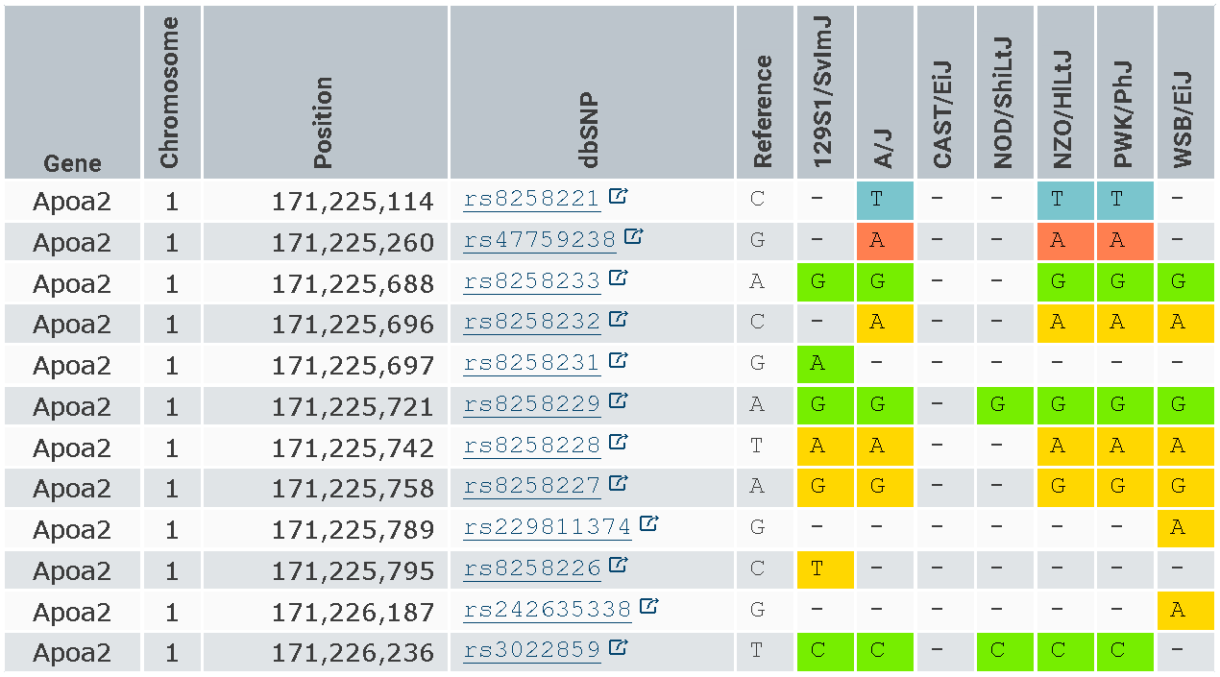
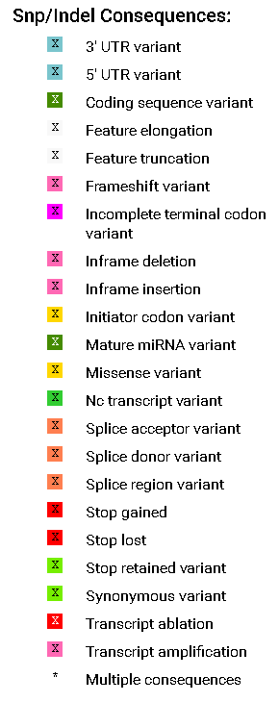
Founder Strain Sequences are available from the Sanger Mouse Genomes Project
http://www.sanger.ac.uk/resources/mouse/genomes/
Notes:
<number>

Slide 30
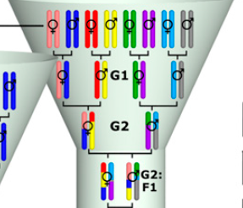
Mouse Collaborative Cross
M
Y
M
Y
M
Y
M
Y
Collaborative Cross Consortium, Genetics; 2012
<number>
Notes:
Why would you want to vary the founder order at the top of the funnel?
What is different about each CC line?
Which founder contributes the M chromosome?
Which founder contributes the Y chromosome?
<number>

Slide 31
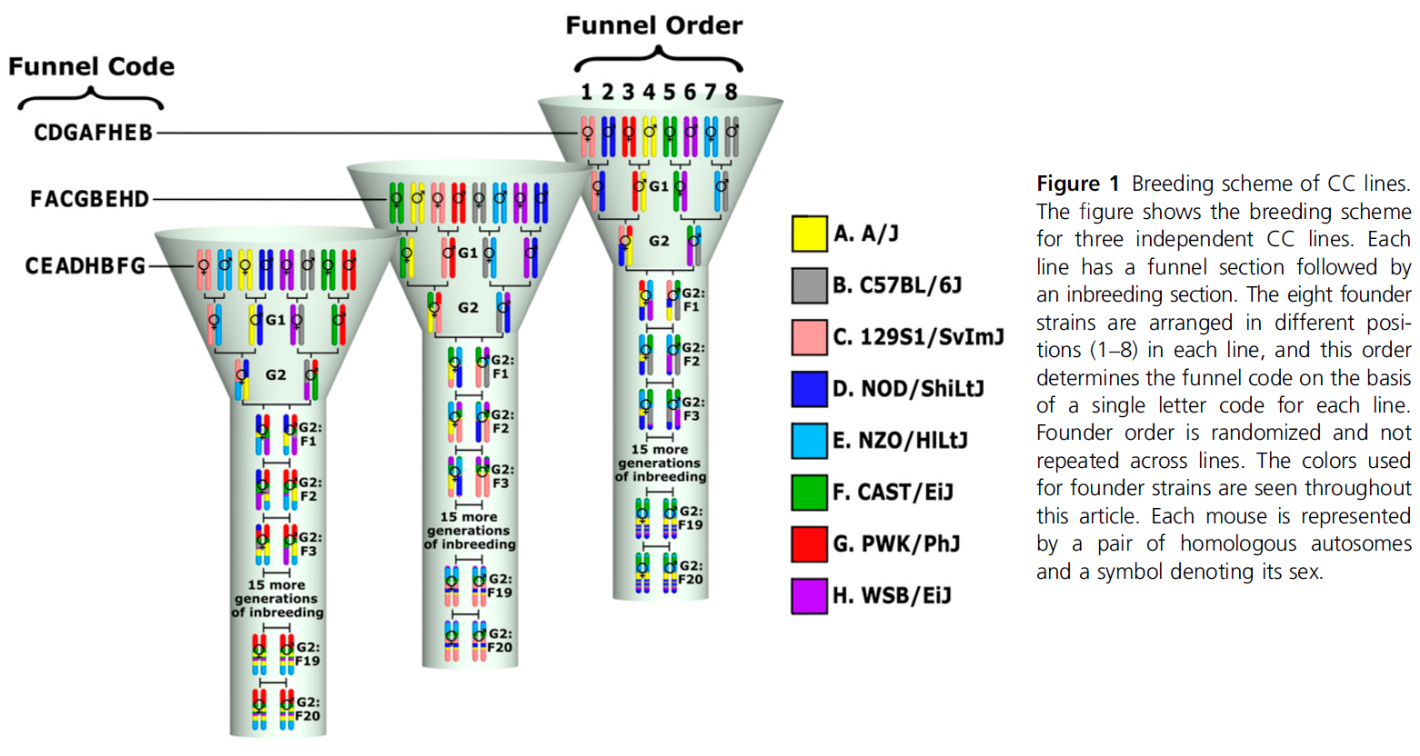
Mouse Collaborative Cross
Collaborative Cross Consortium, Genetics; 2012
<number>

Slide 32
Mouse Collaborative Cross
Each line is (mostly) inbred.
Roughly 200 recombinations per line.
Useful to compare control and treated groups.
Useful when multiple replicates of the same genotype are needed (noisy traits).
http://csbio.unc.edu/CCstatus/index.py
<number>

Slide 33
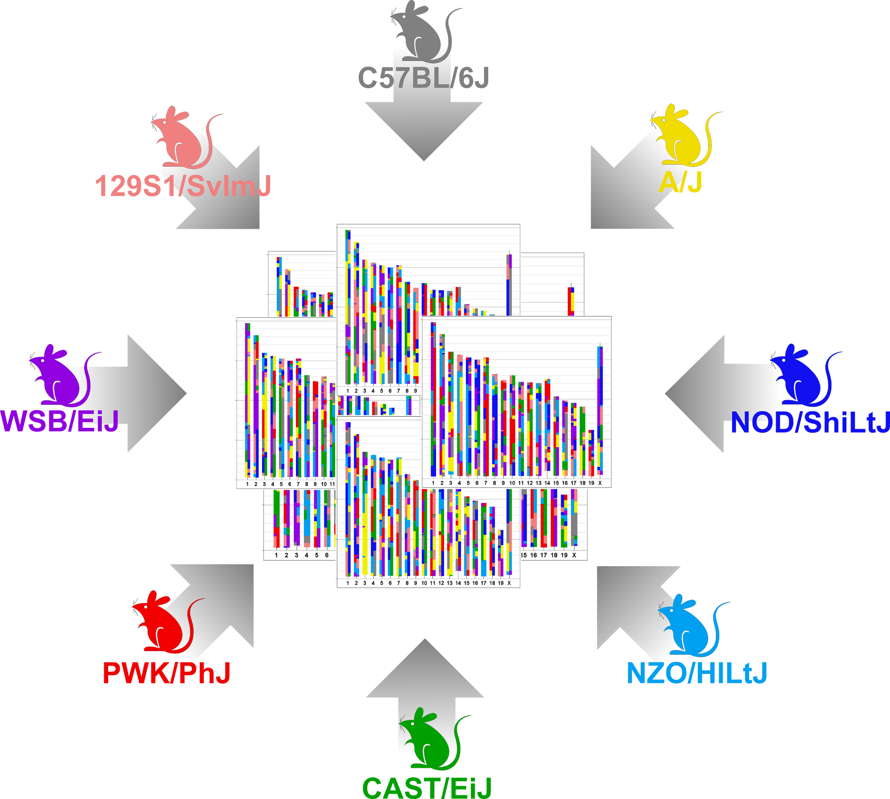
Diversity Outbred Mice
Same 8 founders as Collaborative Cross.
Maintained as an outbred population via random mating.
http://jaxmice.jax.org/strain/009376.html
http://do.jax.org
<number>

Slide 34
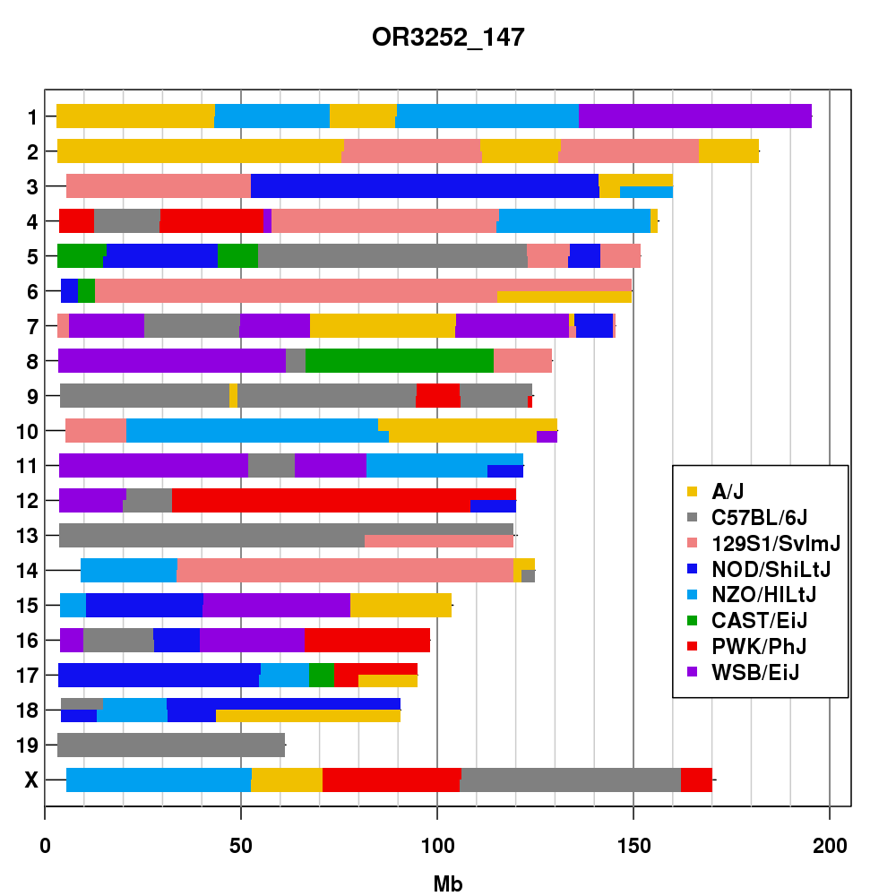
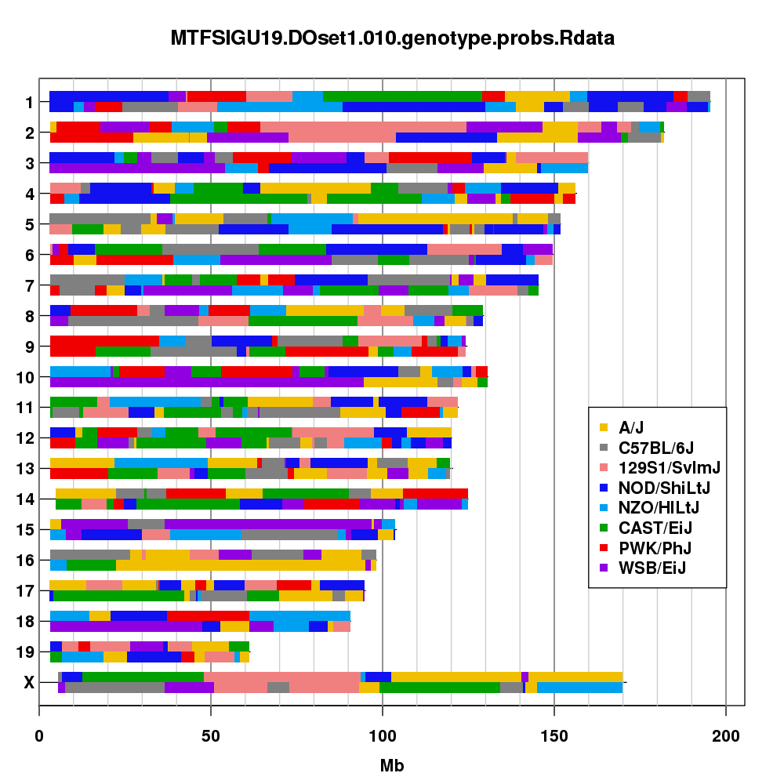
CC and DO Genome Comparison
Collaborative Cross Line
Diversity Outbred Mouse
<number>

Slide 35
CC and DO Comparison
Collaborative Cross
Multiple replicates of same genotype.
Genotype each line (reduced cost).
Fewer recombinations per line (~200 per line).
Higher power.
Diversity Outbred
Each mouse is genetically unique.
Genotype each mouse.
Increasing recombinations with each generation (~500 at G19).
Finer mapping resolution.
<number>

Slide 36

Summary
Increased genetic diversity increases the number of genes with differential expression or altered protein structure.
There are two major mouse crosses derived from the same 8 founder strains:
Collaborative Cross: inbred strains.
Useful when replicate measurements are needed.
Mapping power is higher, but mapping resolution is lower.
Diversity Outbred: outbred population.
Useful for high resolution genetic mapping and correlations between phenotypes.
Mapping power is lower, but mapping resolution is higher.
<number>

Slide 37
Outline
Laboratory Mice
QTL mapping in two parent crosses
QTL mapping in eight parent crosses
Genotyping
Mapping
Diversity Outbred QTL mapping example
Chemotherapy Toxicity
<number>

Slide 38
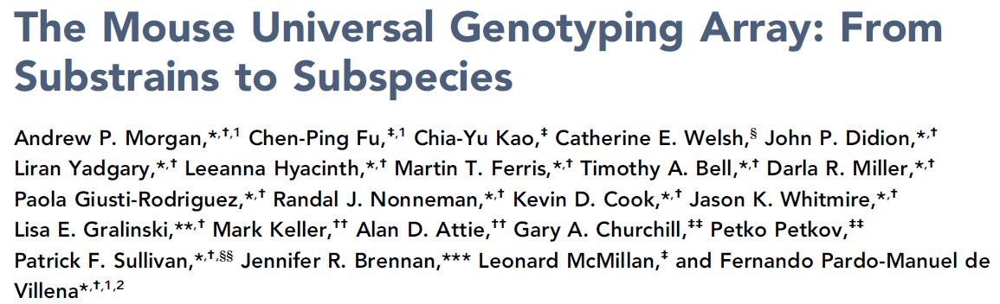
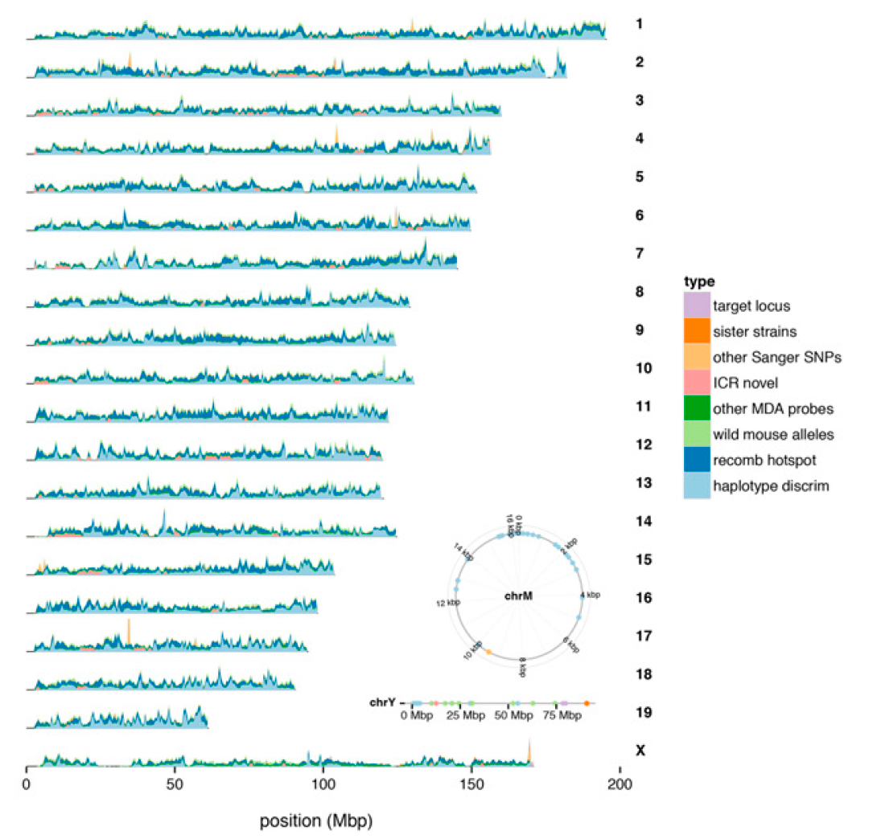
Mice are genotyped on a high density SNP microarray
GigaMUGA
141,090 SNPs
$100 per sample
http://www.g3journal.org/content/6/2/263
<number>

Slide 39
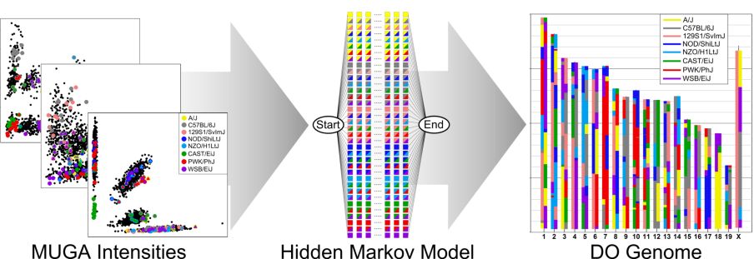
HMM to Reconstruct Genomes

Slide 40
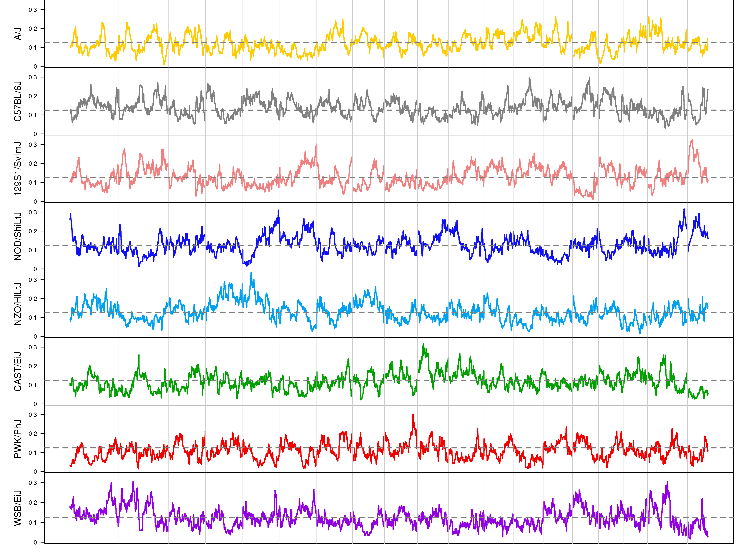
DO Mice have Balanced Founder Allele Proportions across the Genome
A/J
C57BL/6J
129S1/SvImJ
NOD/ShiLtJ
NZO/HlLtJ
CAST/EiJ
PWK/PhJ
WSB/EiJ

Slide 41
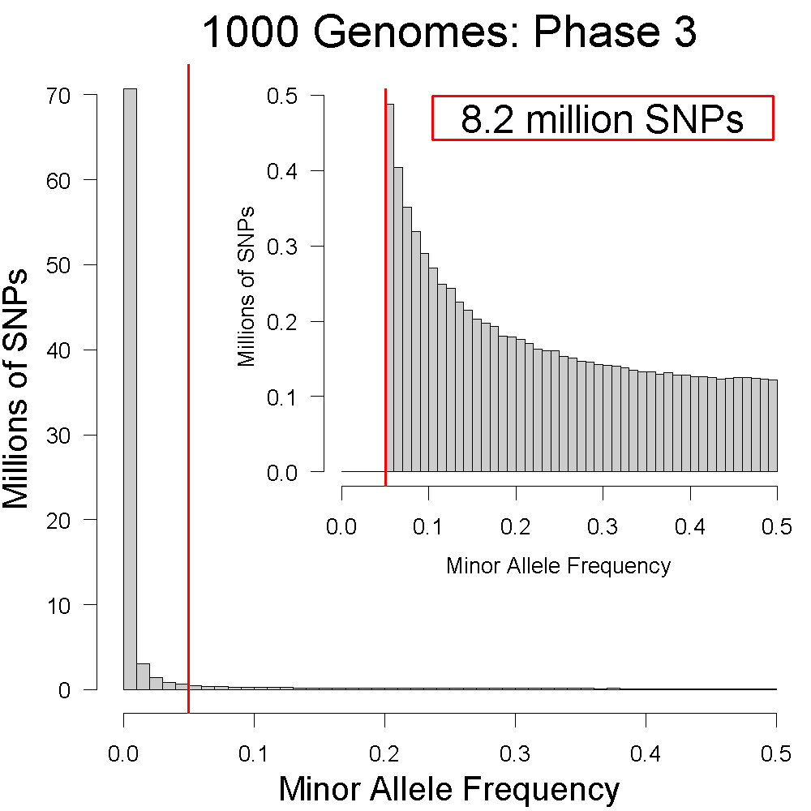
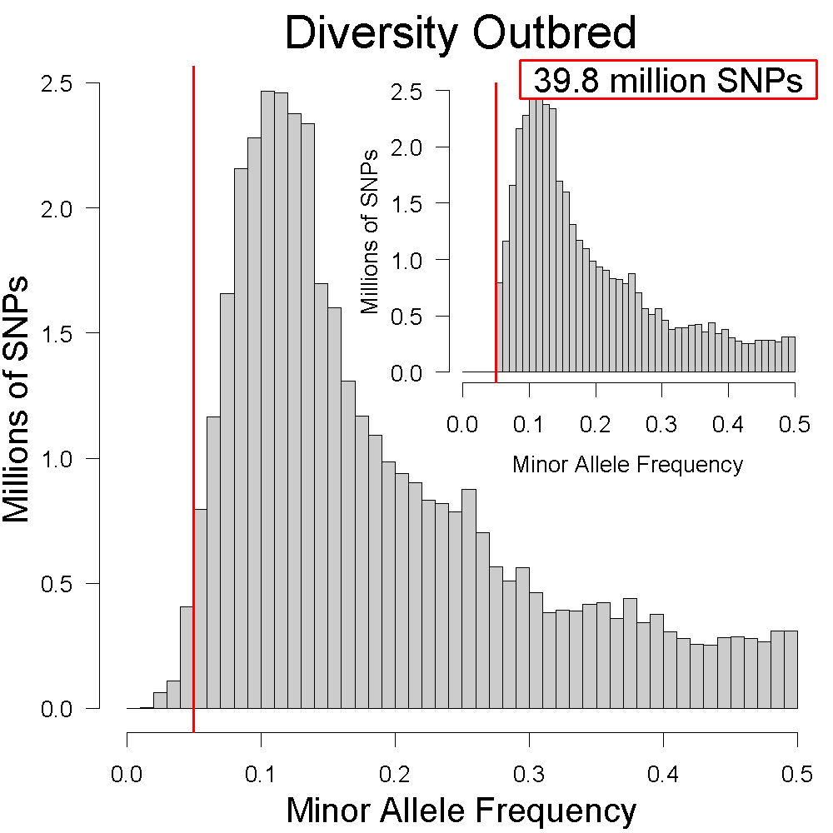
DO Mice have more SNPs with MAF > 5%
1000 Genomes
2,504 samples
84,801,880 SNPs
Diversity Outbred
2,936 samples
40,425,646 SNPs
<number>
Notes:
<number>

Slide 42
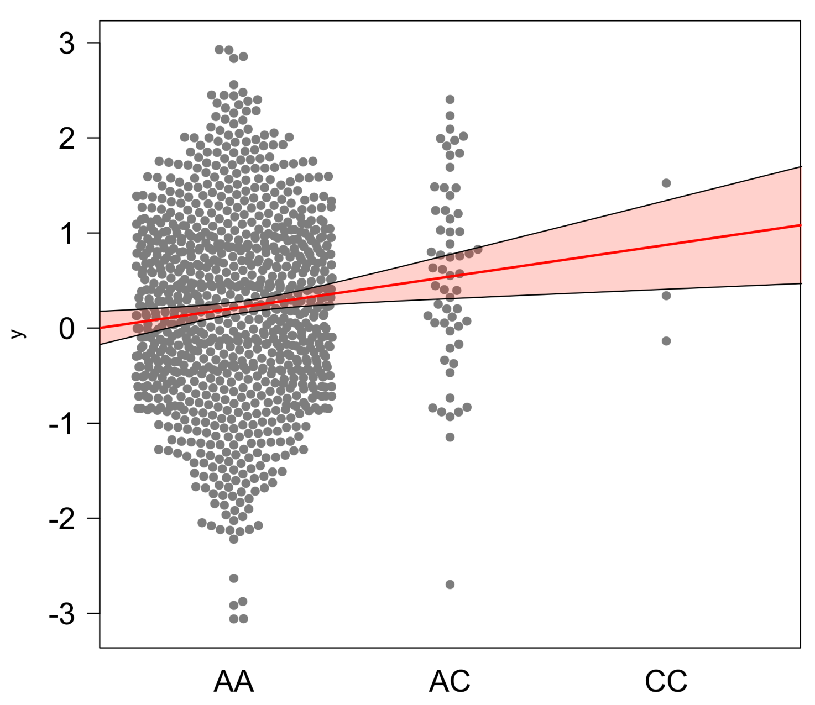
Low minor allele frequency decreases power
n = 1000
MAF = 5%
<number>

Slide 43
Outline
Laboratory mice
QTL mapping in two parent crosses
QTL mapping in eight parent crosses
Genotyping
Mapping
Diversity Outbred QTL mapping example
Chemotherapy Toxicity
<number>

Slide 44
We condense the 36 genotype probabilities to 8 founder haplotype probabilities
For each sample, we have 36 genotype probabilities at each SNP.
We condense these down to 8 state founder probabilities.
AA | AB | AC | AD | AE | AF | AG | AH | BB | BC | BD | BE | BF | BG | BH | CC | CD | CE | CF | CG | CH | DD | DE | DF | DG | DH | EE | EF | EG | EH | FF | FG | FH | GG | GH | HH
0 | 0 | 0 | 0 | 0 | 0 | 0 | 0 | 1 | 0 | 0 | 0 | 0 | 0 | 0 | 0 | 0 | 0 | 0 | 0 | 0 | 0 | 0 | 0 | 0 | 0 | 0 | 0 | 0 | 0 | 0 | 0 | 0 | 0 | 0 | 0
0 | 0 | 0 | 0 | 0 | 0 | 0 | 0 | 0 | 0 | 0 | 0 | 0 | 0 | 1 | 0 | 0 | 0 | 0 | 0 | 0 | 0 | 0 | 0 | 0 | 0 | 0 | 0 | 0 | 0 | 0 | 0 | 0 | 0 | 0 | 0
0 | 0 | 0 | 0 | 0 | 0 | 0 | 0 | 0 | 0 | 0 | 0 | 0 | 0.5 | 0.5 | 0 | 0 | 0 | 0 | 0 | 0 | 0 | 0 | 0 | 0 | 0 | 0 | 0 | 0 | 0 | 0 | 0 | 0 | 0 | 0 | 0
A | B | C | D | E | F | G | H
0 | 1 | 0 | 0 | 0 | 0 | 0 | 0
0 | 0.5 | 0 | 0 | 0 | 0 | 0 | 0.5
0 | 0.5 | 0 | 0 | 0 | 0 | 0.25 | 0.25

Slide 45
The mapping model estimates the effect of each founder allele
http://do.jax.org

Slide 46
Mapping Additive Effects in F2
$y_{im}=μ+g_{im}α_{m}+ε_{im}$

Slide 47
Example: Coat Color
Coat color in ~150 DO mice recorded as:
Albino
Agouti
Black
Mapped Albino and Black separately as binary traits.
Both are homozygous recessive traits.
Albino is epistatic to black.

Slide 48
Linkage versus Association Mapping
Linkage mapping associates the phenotype with a haplotype.
Association mapping associates the phenotype with a genomic variant (like a SNP).
<number>

Slide 49
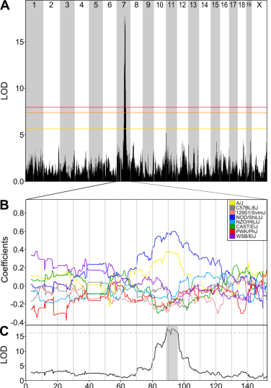
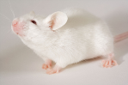
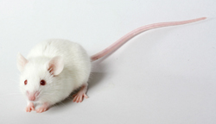
Albino
A/J
Svenson et.al. Genetics, 2011
Tyr^{c}
NOD/ShiLtJ

Slide 50
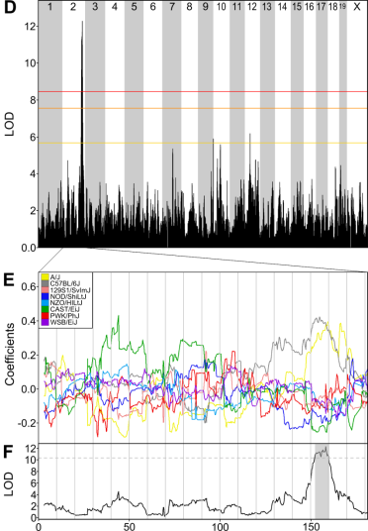
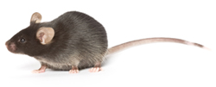
Black
A/J
Svenson et.al. Genetics, 2011
a
C57BL/6J

Slide 51
Modifier mapping using the DO
TRAMP
<number>

Slide 52
Summary
DO mice are genotyped using a microarray with ~140,000 SNPs.
The genomes of DO mice can be reconstructed in terms of the eight founder haplotypes.
The DO has balanced allele frequencies, which maximizes the number of SNPs that we can use in mapping.
We can estimate the effects of the eight founder alleles in the DO.
Modifiers of dominant genes can be mapped using DO F1s.
<number>

Slide 53
Outline
Laboratory mice
QTL mapping in two parent crosses
QTL mapping in eight parent crosses
Genotyping
Mapping
Diversity Outbred QTL mapping example
Chemotherapy Toxicity
<number>

Slide 54
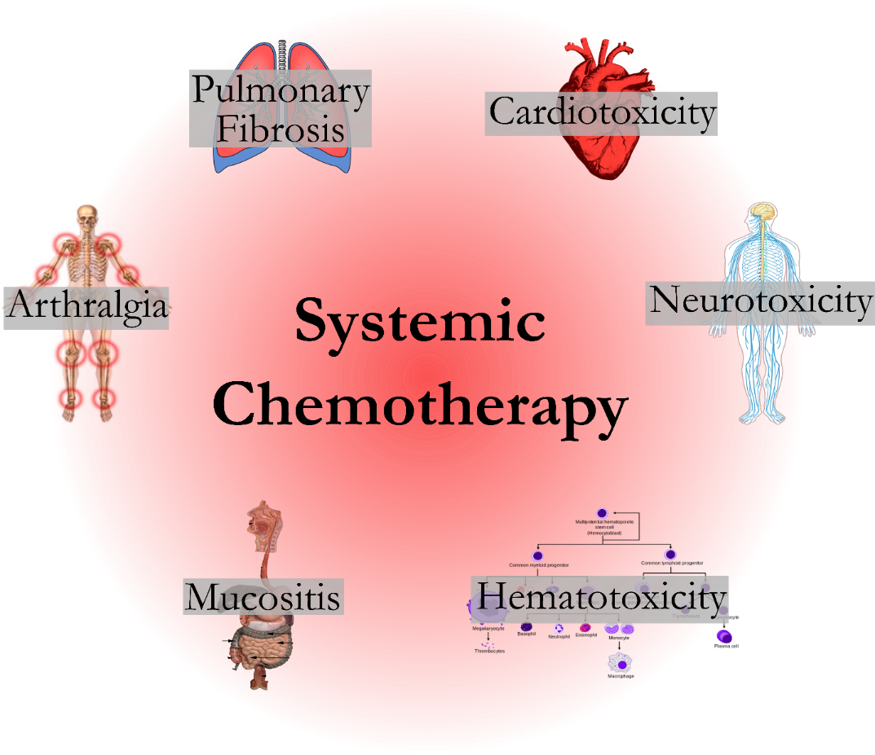
Chemotherapy drugs cause a wide range of toxicities
<number>

Slide 55
Chemotherapy-Induced Toxicities are an area of increasing concern
Increased funding and interest from government and clinical organizations.
Increased interest from patient advocacy groups.
Difficult to perform a well-powered GWAS to look at toxicity.
Toxicity is often a secondary aim.
Drugs often dosed in combination.
Data is of varying quality.
<number>

Slide 56
Drug Regimens in DO Study
Drug(s) | Dose | Type | Samples
Doxorubicin | 20 mg/kg | Topoisomerase II Inhibitor | 400
Doxorubicin + GCSF | 20 mg/kg + 150 mg/kg | Topoisomerase II Inhibitor | 200
Cyclophosphamide | 200 mg/kg | DNA alkylating | 200
Docetaxel | 30 mg/kg | Microtubule stabilizer | 200
<number>

Slide 57
PMID: 28607509
Acute Neutropenia Study Design
Male and female Diversity Outbred mice.
Sacrifice at 5 or 6 days
Endpoint: change in blood cell counts.
Primarily interested in neutropenia.
0
6
Blood Collection
<number>

Slide 58
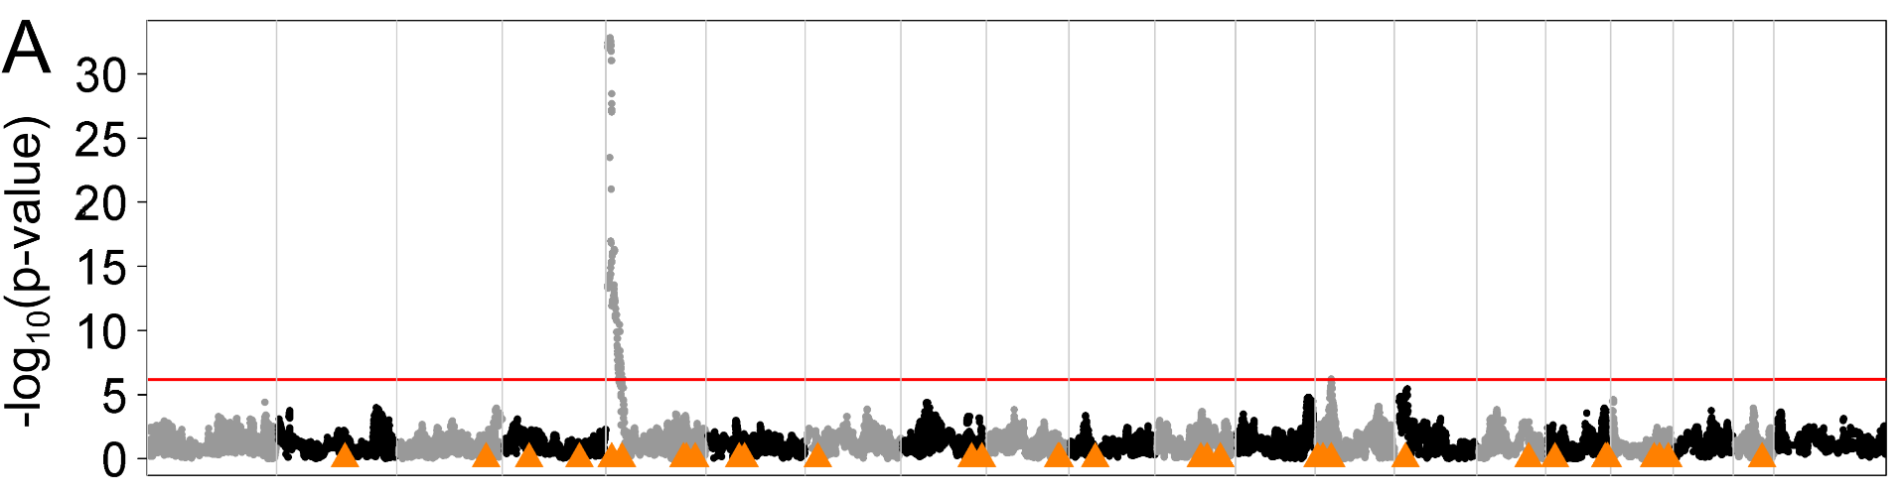
Doxorubicin-induced change in neutrophils has a QTL on proximal Chr 5
40 million SNPs
<number>

Slide 59
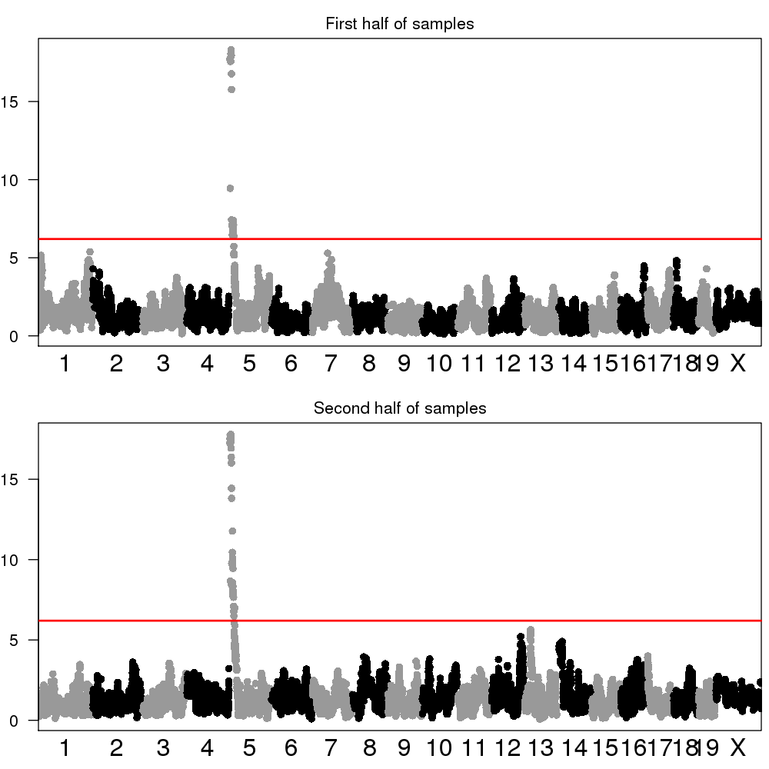
Results in DO mice are Reproducible at the Population Level
First Cohort
Second Cohort
<number>

Slide 60
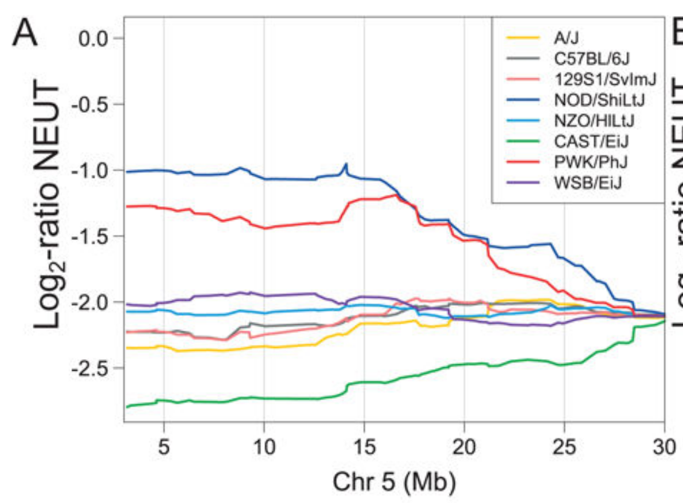
The Chr 5 QTL has complex founder allele effects

Slide 61
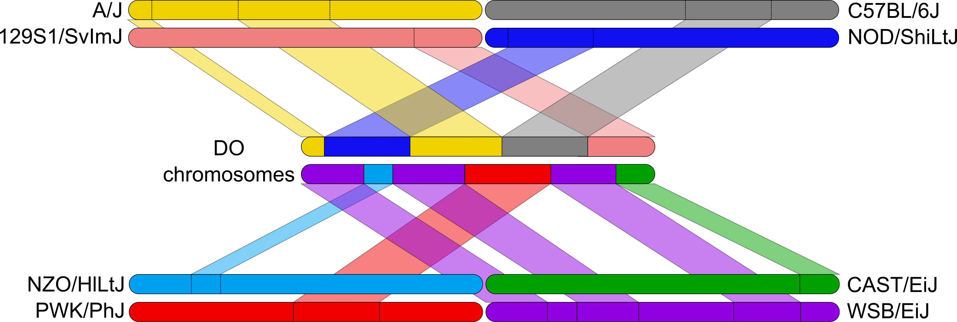
We can impute 40 million SNPs onto DO genomes
Impute SNPs onto DO genomes
<number>

Slide 62
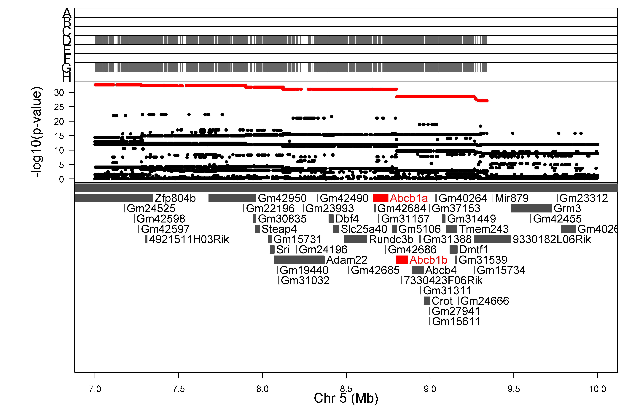
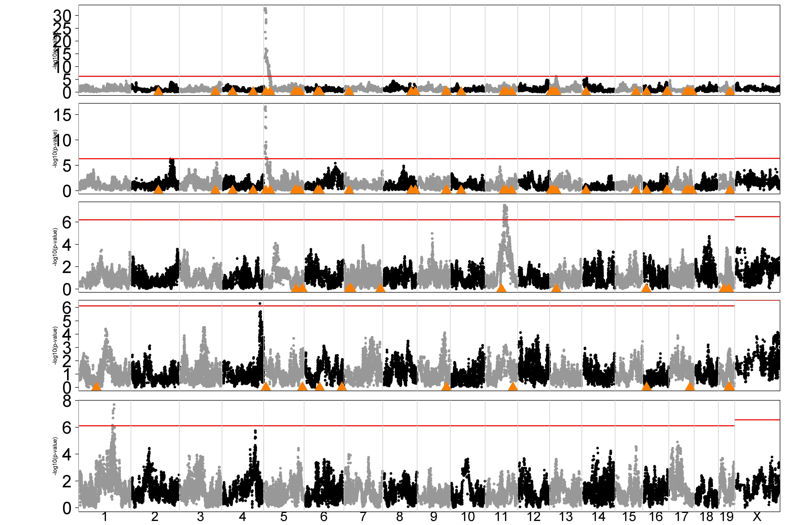
Doxorubicin-induced neutropenia is influenced by variants near Abcb1a & b (multidrug resistance genes)
MDR1 or P-glycoprotein

Slide 63
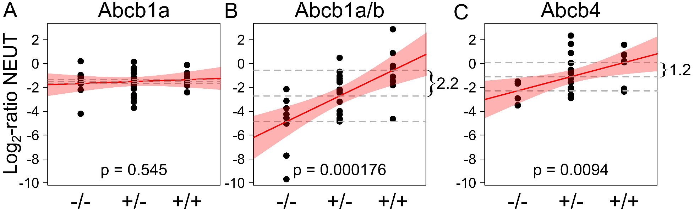
Abcb1b & Abcb4 Knockouts affect Doxorubicin-induced Neutropenia
PMID: 28607509
<number>

Slide 64
Acknowledgements
The Jackson Laboratory
Gary Churchill
Bob Braun
Elissa Chesler
Karen Svenson
Steven Munger
Narayanan Raghupathy
Al Simons
Kwangbom Choi
Anne Greenlee
Joel Graber
Steve Ciciotte, Lisa Somes,
Doug Hinerfeld / Sandy Daigle/
Niel Goodwin
UNC-CH
Fernando Pardo-Manuel de Villena
Daniel Pomp
Leonard McMillan
Catherine Walsh
Cheng-ping Fu
Andrew Morgan
Univ. of Wisconsin
Karl Broman
Univ. of Chicago
Abraham Palmer
Riyan Cheng
NIEHS
John E. French
Kristine Witt
Daniel Morgan
Grace Kissling
Keith Shockley
ILS, Inc.
Kim Shepard
Leslie Recio
Alion
Herman Price

Slide 66
Outline
Inbred mice
QTL mapping in two parent crosses
QTL mapping in eight parent crosses
Genotyping
Mapping
Diversity Outbred QTL mapping example
Benzene toxicity
<number>

Slide 67
Benzene Inhalation Study
Day 0
7
14
21
28
0 ppm
75+75
1 ppm
75+75
10 ppm
75+75
100 ppm
75+75
6 hrs per day
5 days per week
<number>

Slide 68
Benzene Study Endpoints
Pre- and post-exposure blood
Post-exposure bone marrow
Proportion of micronucleated reticulocytes (MN-RET)
Measure of chromosomal damage
French, JE, et.al, Env. Health Persp., 2014
http://www.ncbi.nlm.nih.gov/pubmed/25376053
<number>

Slide 69
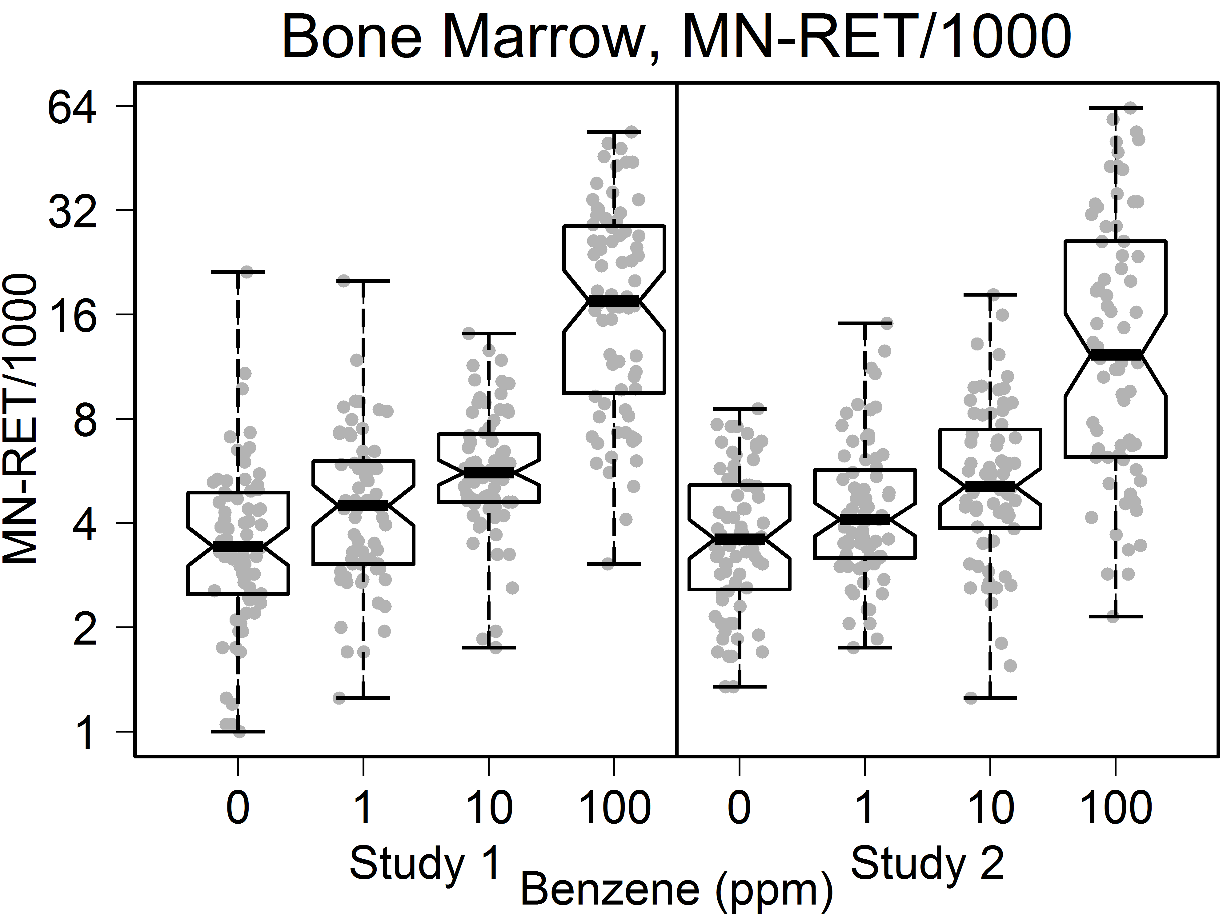
Bone Marrow MN-RET
DNA
Damage
<number>

Slide 70
Linkage Mapping Model
Map with 150 samples from 100 ppm dose.
y_{i} = phenotype for sample i.
β_{j} = founder allele effect for founder j.
h_{ij} = founder haplotype contribution for sample i for founder j.
λ_{i} = correction for population structure.
<number>

Slide 71
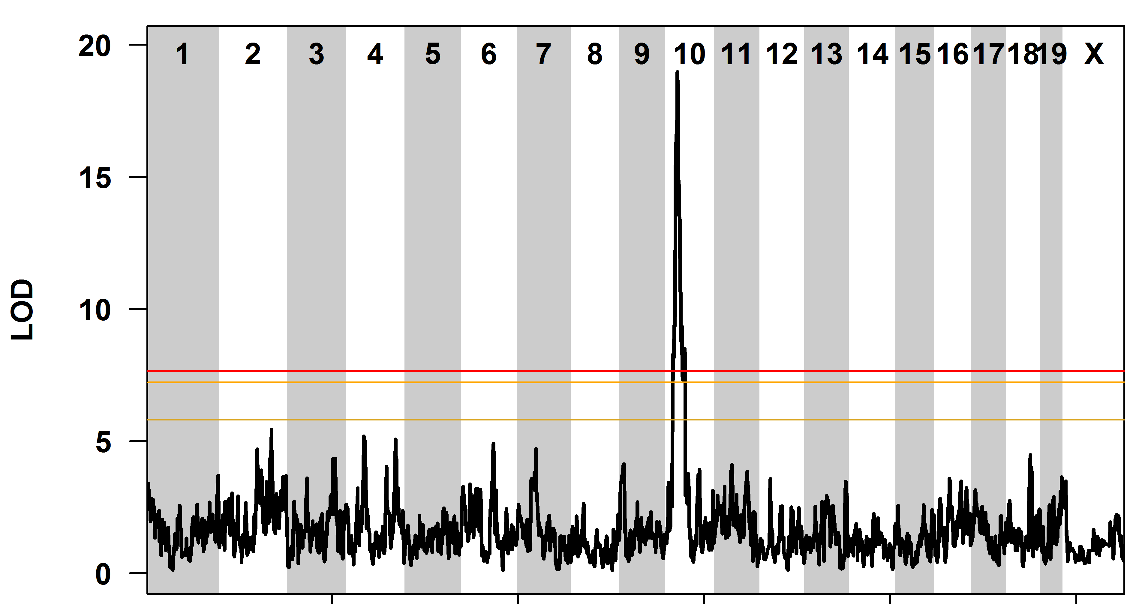
QTL Plot of Bone Marrow MN-RET
<number>

Slide 72
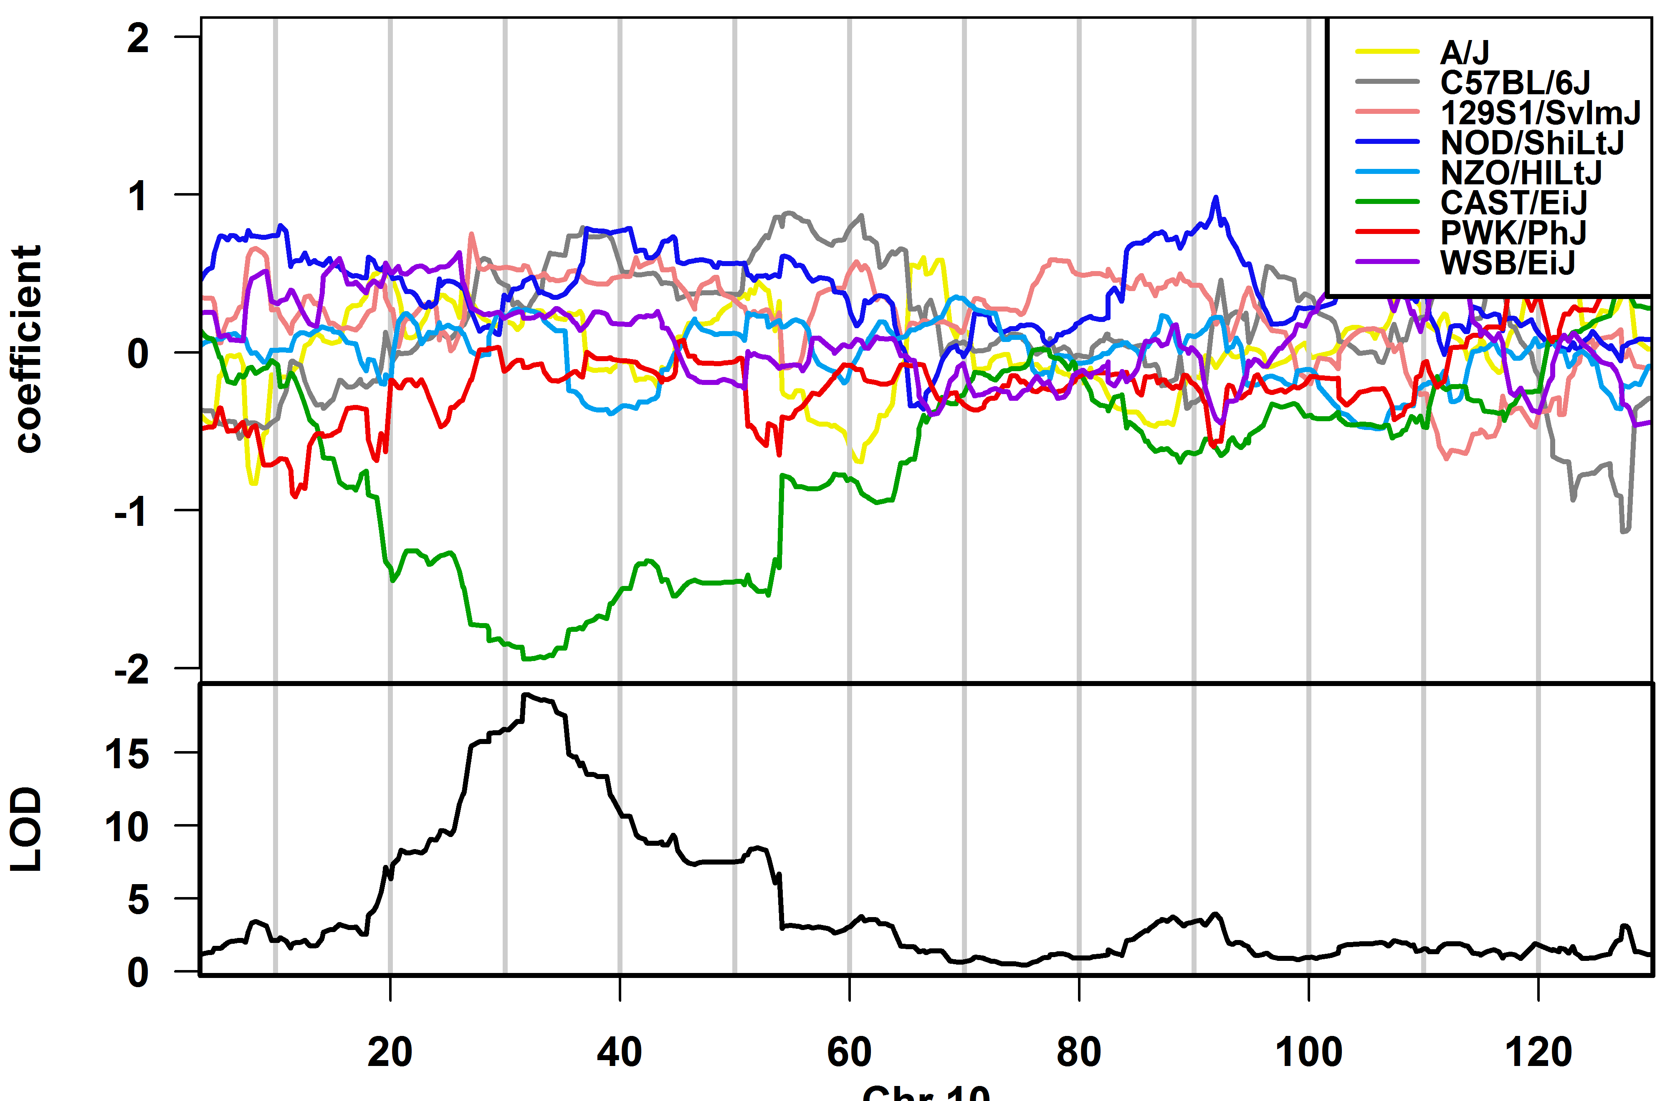
The CAST allele is protective
DNA
Damage
Chr 10
<number>

Slide 73
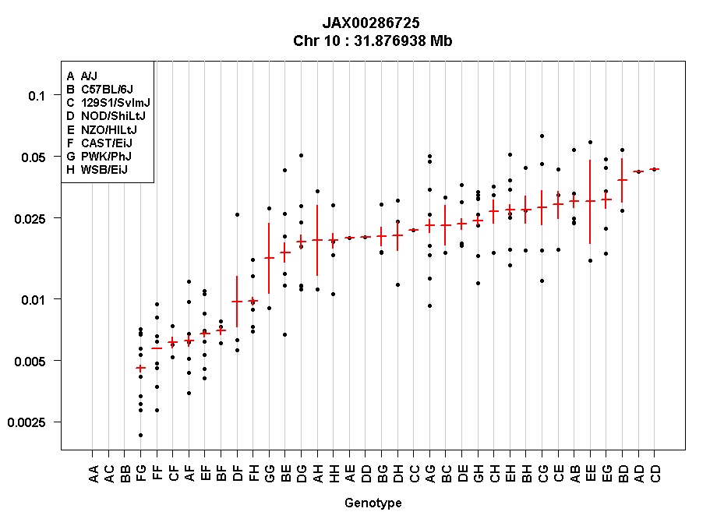
The CAST allele is dominant
Prop. MN-RET
Genotype
<number>

Slide 74
Association Mapping to narrow candidate gene list
Founders have been sequenced.
We have founder haplotypes for the DO.
Map founder sequences onto DO.
QTL map using smaller, three genotype model.
<number>

Slide 75

Association Mapping to narrow candidate gene list
Founders have been sequenced.
We have founder haplotypes for the DO.
Map founder sequences onto DO.
QTL map using smaller, three genotype model.
DO | # | Geno
AB | 0+1 | 1
BB | 1+1 | 2
AC | 0+0 | 0
BE | 1+1 | 2
DE | 0+1 | 1
One Sanger SNP
A | B | C | D | E | F | G | H
0 | 1 | 0 | 0 | 1 | 1 | 0 | 0
0
1
2
<number>

Slide 76
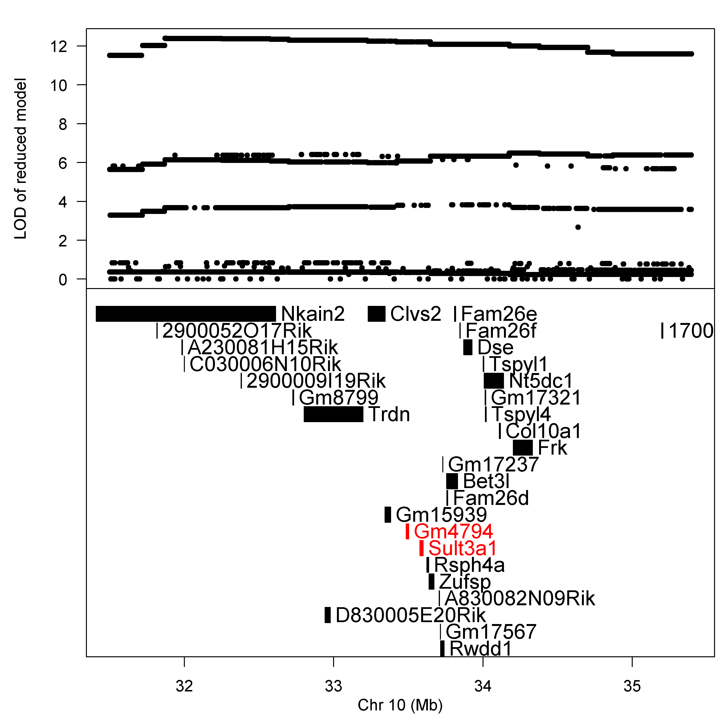
Sult3a1 and Gm4794 are sulfotransferases
<number>

Slide 77
Sult3a1 and Gm4794 have high expression in CAST livers
http://cgd.jax.org/gem/strainsurvey26/v1
<number>

Slide 78
The CAST allele of Sult3a1 & Gm4794 is more highly expressed than other alleles
French JE, et al., Env. Health Persp., 2015
<number>

Slide 79
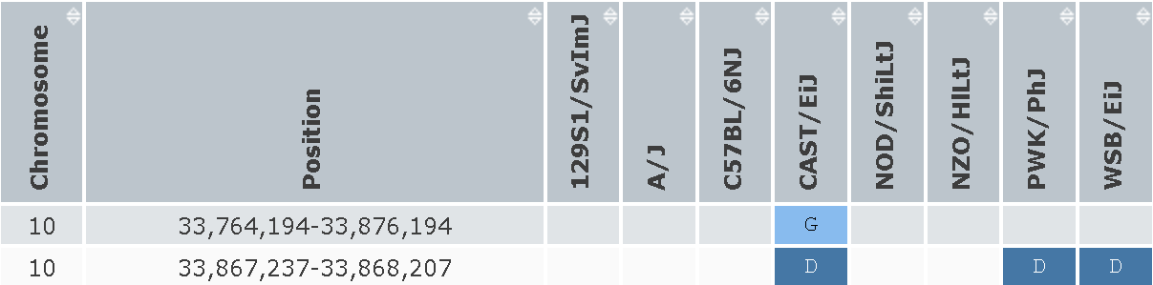
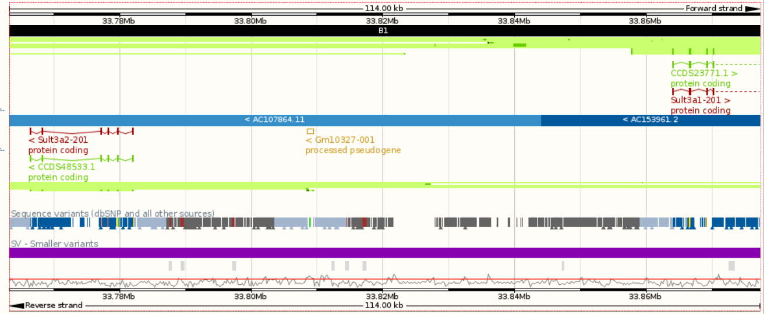
CAST/EiJ has a copy number gain of sulfotransferases
http://www.sanger.ac.uk/sanger/Mouse_SnpViewer/rel-1303
Sult3a2
Sult3a1
http://ensembl.org
<number>

Slide 80
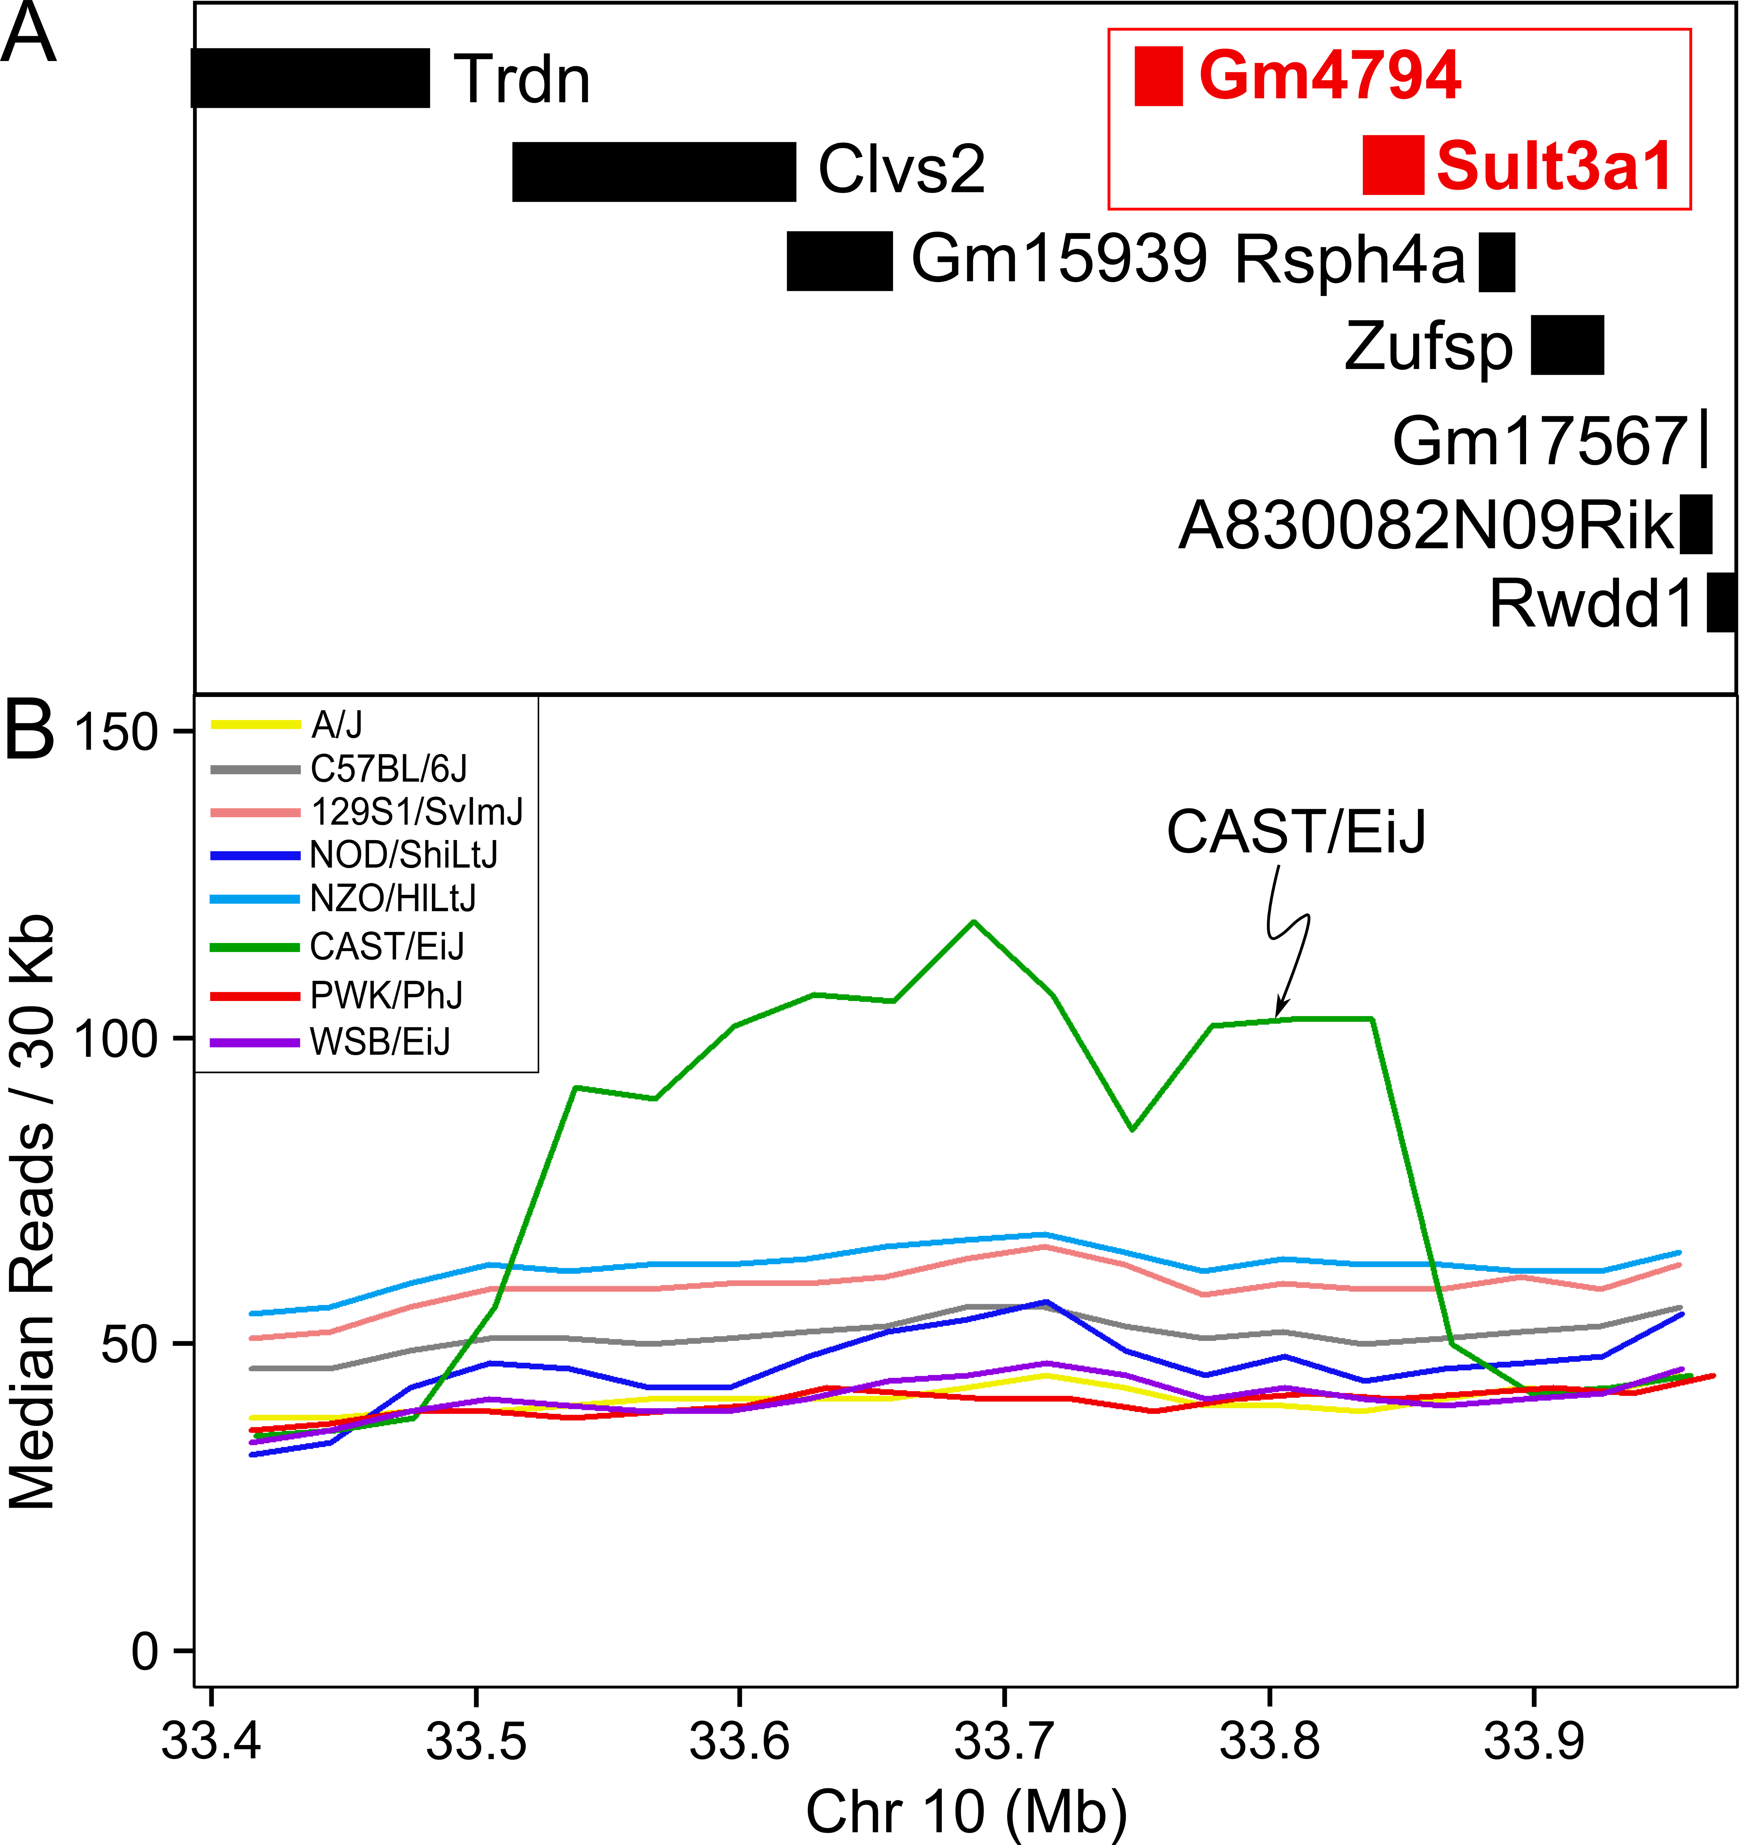
CAST/EiJ has a copy number gain of sulfotransferases
<number>

Slide 81
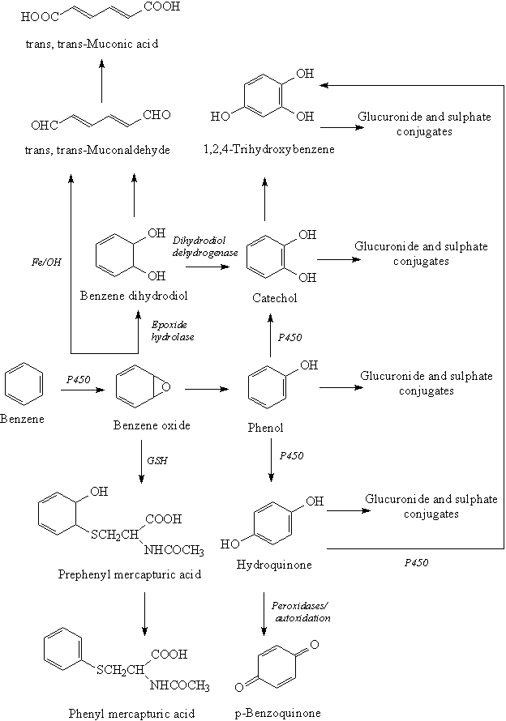
Hypothesis
Sulfate conjugation leads to excretion
Metabolite produces ROS
http://www.crios.be/Benzene/
<number>

Slide 82
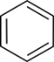
Hypothesis
Mice with other allele at Chr 10 QTL
Active metabolites
Bone Marrow
Liver
DNA Damage
Less excretion
Mice with CAST/EiJ allele at Chr 10 QTL
Active metabolites
Bone Marrow
Liver
Less DNA Damage
More excretion
<number>

Slide 83
Summary
QTL mapping studies generate testable hypotheses.
i.e. Gene X affects phenotype Y.
Benzene-induced hematotoxicity is affected by a dominant, protective CAST allele.
CAST carries a duplication of a pair of sulfotransferases that increases constitutive liver expression.
Sulfation of benzene metabolites is a plausible detoxification mechanism.
<number>

